Slide 1

Tickest – sprint I recap
Android app for events booking - SKG.Code Bootcamp

Slide 2













Tools & Technologies
Back-end Development
Front-end Development
API Server
Node.js & Express.js
Database & ORM
MongoDB Atlas & Mongoose
Hosting
Render.com
Insomnia
API Testing
Env Vars
Dotenv
Auto-reload
Nodemon
Repository & CI
GitHub
Android Development
Android Studio & Kotlin
RecyclerView
Android Jetpack
HTTP Client
Retrofit
Glide
Image Loading
Planned
Firebase Authentication
UI Mockups
Figma
Repository & CI
GitHub

Slide 3

What We Built – Highlights
Front-end Highlights
(Kostantinos Mourousidis, Evdokia Voultsiou)
Back-end Highlights
(Efstratia Geragoteli, Evdokia Voultsiou)
Search Screen
Results List
Detail Screen
Networking (Retrofit)
Data Binding & ViewModel
Figma Integration
Event Model (Mongoose)
Seed Script
Deployment
CRUD Endpoints
PATCH Endpoints

Slide 4
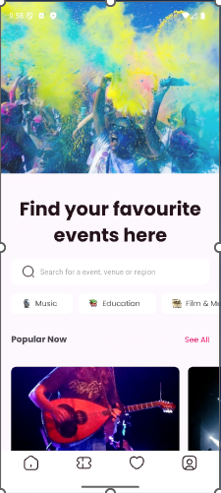
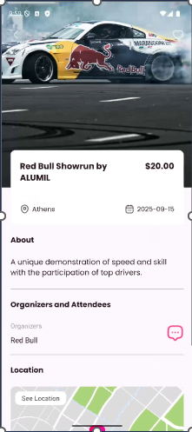
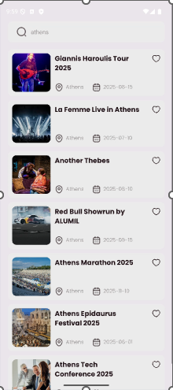
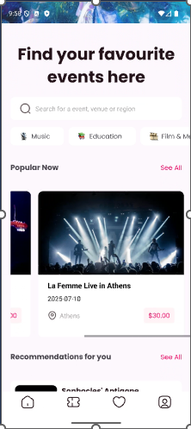
Sprint 1 Goals – Frontend Sprint Backlog
1st View: Home - Filtering
As a user, I want to search and filter events so that I only see events in my city/category/date range.
2nd View: Listed Preview of Events
3rd View: Event’s Detailed Preview
As a user, I want to tap an event preview to view full details.
Popular Events - Carouzel
As a user, I want to see a list of events matching my search and filters.
As a user, I want to see a horizontal carousel of the most anticipated events.

Slide 5
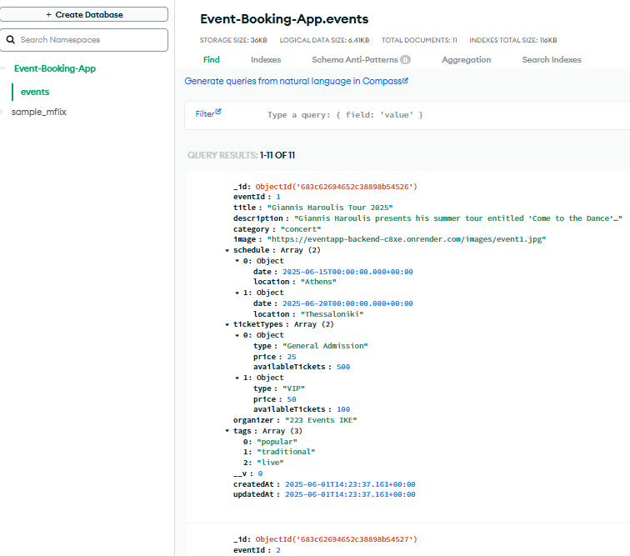
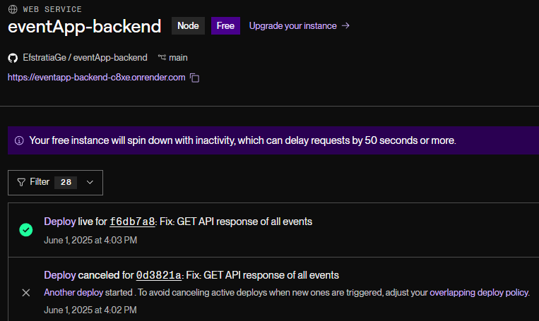
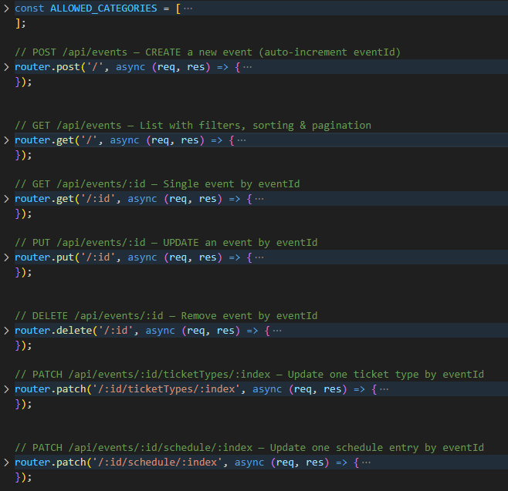
Sprint 1 Goals - Backend Sprint Backlog
API & DB Testing
As a DBA, I want to seed the database with dummy data so that the front-end can test against real-looking events.
CRUD API & DB Connection
As a developer, I want to build a RESTful API with Node.js for all CRUD operations.
BackEnd Hosting & Connection to FrontEnd
As a developer, I want to host my backend repo to Render, so that the frontend dev can fetch the data.

Slide 6

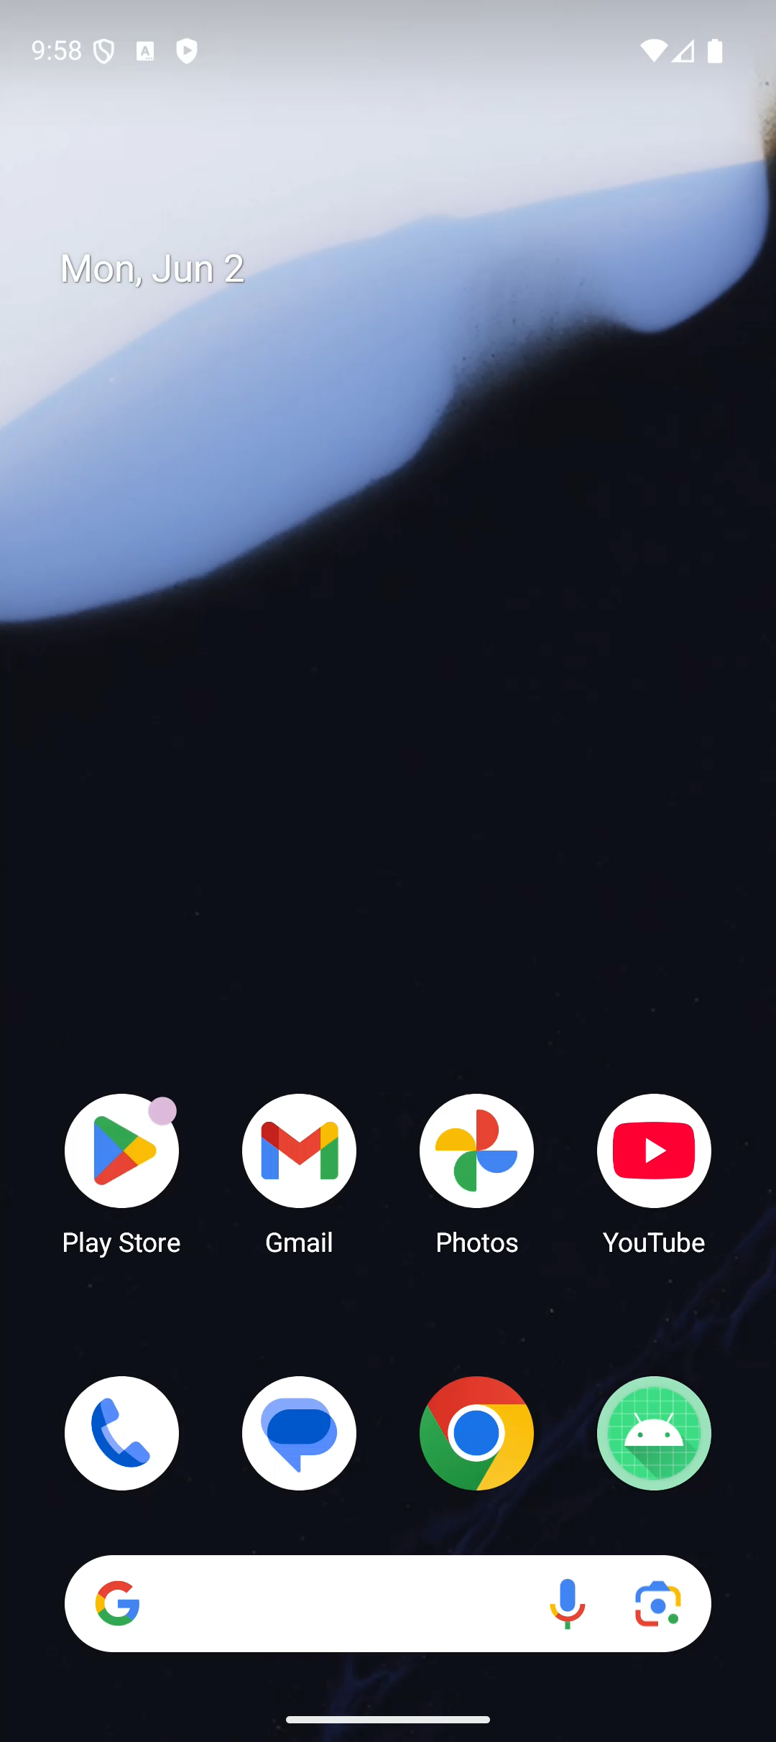
Demo of Current Flow

Slide 7

Goals for Next Sprint
Popular Events feature by click
Favorites View
Google Map Feature (redirection)
Basket/ Cart View
User’s Sign up – User Collection MongoDB
Scroll View of All Categories

Slide 8


Thank You
Feel free to ask any questions!

